Slide 1
LOGIC Gates- PART-B

Slide 2
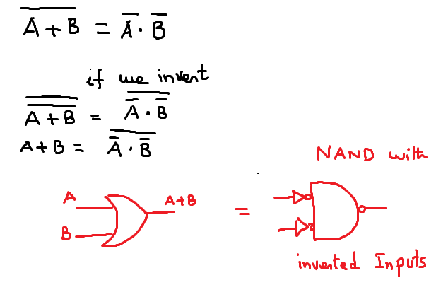
OR Gates is nothing but a NAND gate with an invertor

Slide 3
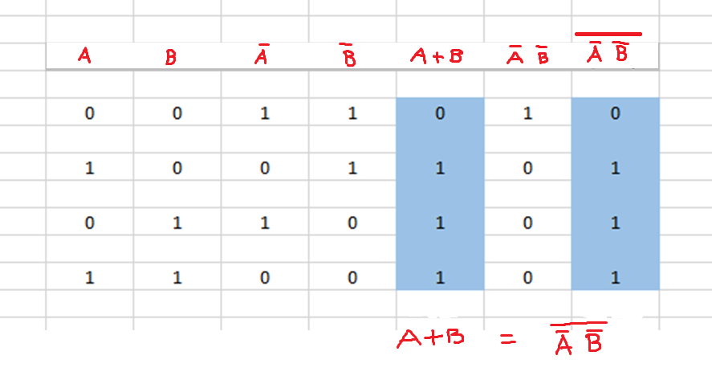
Truth Table to verify

Slide 4
This means that an OR gate operates identically to a NAND gate
with inverted inputs. This is also true for OR gates with three or more
inputs.

Slide 5
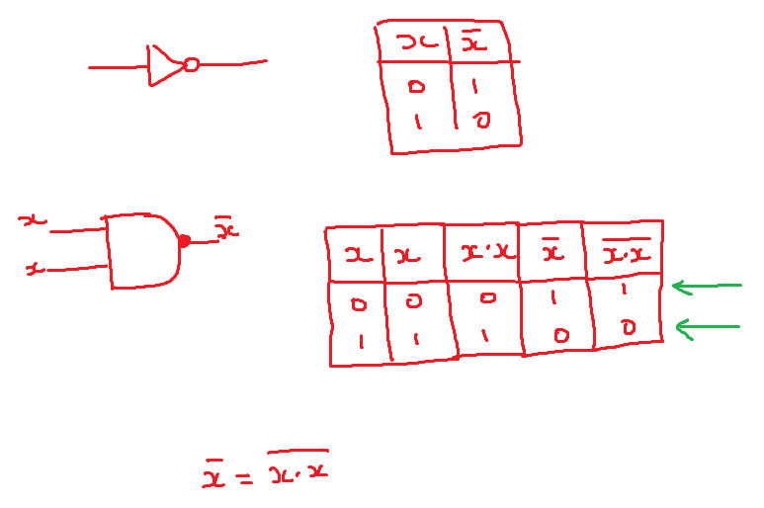
Invertor is same as NAND

Slide 6
NAND Gate represented as vertical bar |

Slide 7
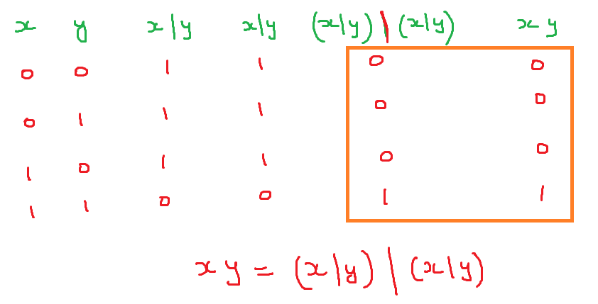
NAND operator same as AND

Slide 8
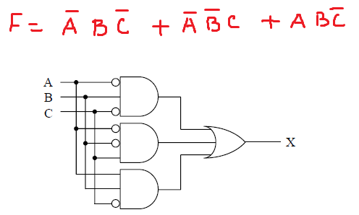
Converting A SOP expression into Digital Circuit
From the book - COMPUTER ORGANIZATION AND
DESIGN FUNDAMENTALS by David Turnoff

Slide 9
Converting A SOP expression into Digital Circuit

Slide 10
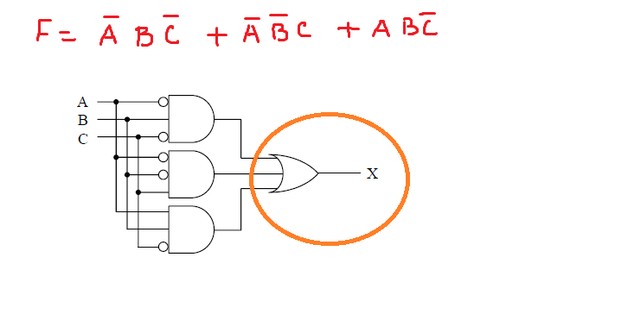

Slide 11
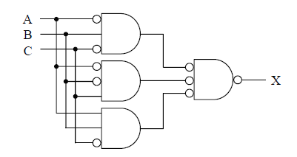
Equivalent circuit is formed

Slide 12
